Slide 1
Healing Hut
Name - Satya Prakash Samal
Class - XII E
1

Slide 2
The Crisis – India’s Mental Health Epidemic
70M+ suffer from mental disorders, mostly untreated due to stigma and poor access.
Severe professional shortage: 0.3 psychiatrists/100K vs 6.6 in developed countries.
1 suicide every 3 minutes, mainly youth aged 15–29.
India is in crisis — youth are dying, and the system can’t handle it.
Source: W.H.O.

Slide 3
The Solution – Healing Hut
Mission: Affordable, private, and mobile-first mental wellness.
Offerings: 1-on-1 video therapy and centralized AI-based self-help tools — all in one platform.
Culturally tailored for India's youth mental health ecosystem.
A digital solution designed to reach and heal India’s youth.

Slide 4
The Opportunity – Explosive Market Growth
$185B global mental wellness market (2022)
India’s market: $2.7B (2025), 20% CAGR, projected $4.5B+ by 2030
Huge gap in access + cultural context = high growth potential
Mental wellness is a booming industry — and India is the next big market.

Slide 5
Target Market – India’s Digital Youth
500M+ Indians (16 to 35 years old) — core audience.
Tier 1 & 2 smartphone adoption: 75%+
Students & early workforce under extreme mental stress
A massive, reachable, and underserved digital-first audience.

Slide 6
Go-To-Market Strategy
B2B: Partner with corporates to reduce employee burnout, lower sick leaves, and enhance productivity, positioned as a cost-saving and wellness-boosting benefit.
B2C: We will reach our core target audience through Meta, Google, and various social media platforms using targeted advertisements and engaging organic content focused on mental health awareness.
Hybrid channels create viral trust and reliable revenue.

Slide 7
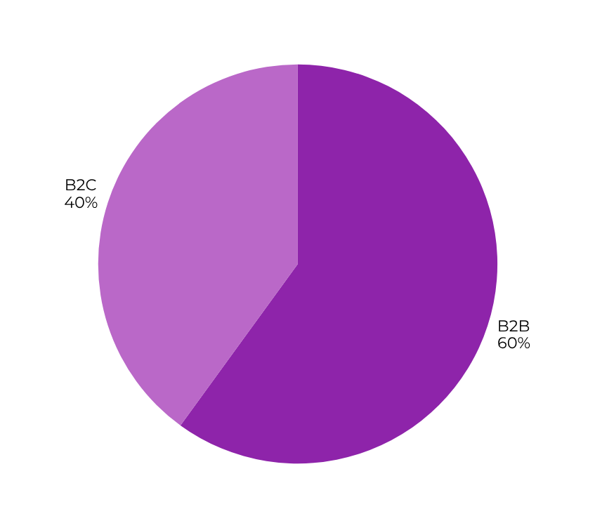
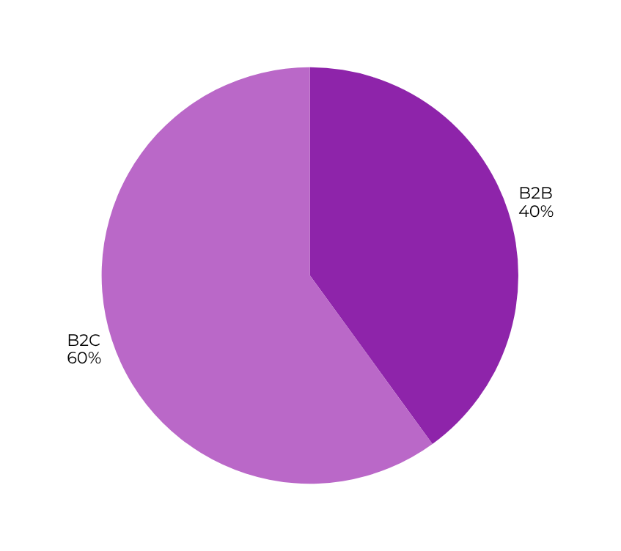
Sales Division Projection
1st - 5th Year
6th - 10th Year
Strategic shift: Building through B2B, scaling through B2C.

Slide 8
B2B Revenue Model (Per-Employee Plans)
We offer tiered monthly plans to companies:
Tier | Price | Features
Essential | ₹ 49 - 99 | AI Powered Mood Tracker, Mental Assesment and Real-time Employee Insight Dashboard
Enhanced | ₹ 149 - 199 | Includes all features from Essential, Discounted therapy sessions, One expert-led Mental Health Workshop per month
Comprehensive | ₹ 299 - 399 | Includes all features from lower tiers, Free 1-on-1 therapy sessions (1 hour/week), crisis management
Companies subscribe to improve productivity, retention, and meet wellness mandates affordably.

Slide 9
B2C Revenue Model
Healing Hut earns via:
Product Marketplace: Non-medical wellness items (aromatherapy, journals, etc.) sold with a 90:10 revenue split (Healing Hut:Therapist)
Therapist-side Commission: 5% fee on sessions priced above ₹199
Customer-side Commission: 1% platform fee per session booked
Affordable access for users, fair earnings for therapists, and scalable revenue for us.

Slide 10
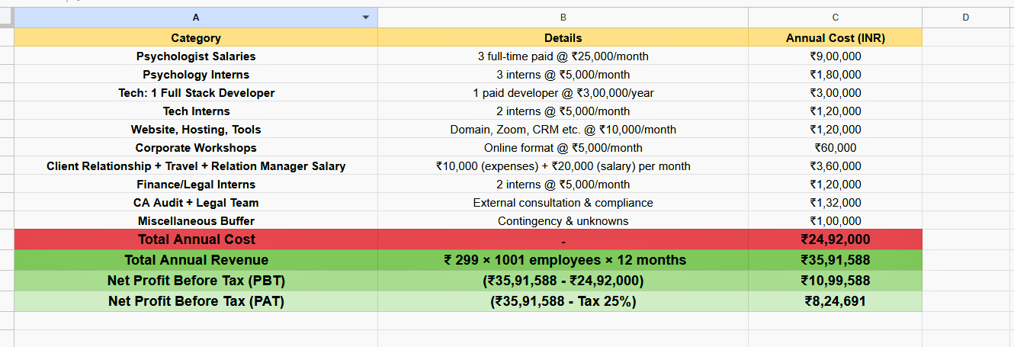
Cost Analysis
(Assumption: 1 Client with 1001 Employees | 200 employees use 1 hr/week therapy)
Every rupee is optimized for impact — building tech, reaching users, and delivering care at scale.

Slide 11
Healing Hut
11

